Slide 1
Step-by-Step: How to make an animated movie
The production pipeline of a typical animated movie:
pre-production
production
post-production

Slide 2
Pre-production
It begins with the main concepts which are initially turned into a full story, and then, once the story has been finalized, other things such as the script, shot sequence and camera angles are worked on.

Slide 3
Pre-production Components
Story Boarding
Model Sheets
Animatic

Slide 4
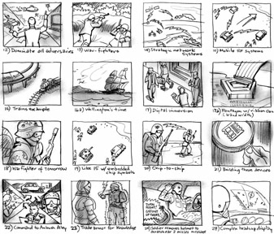
Pre-production: Story Boarding
The Storyboard helps to finalize the development of the storyline.

Slide 5
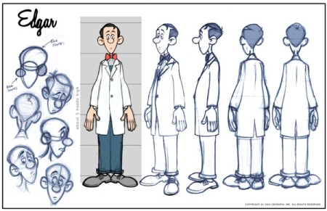
Pre-production: Model Sheets
Model sheets are precisely drawn groups of pictures that show all of the possible expressions and poses the character could do.

Slide 6
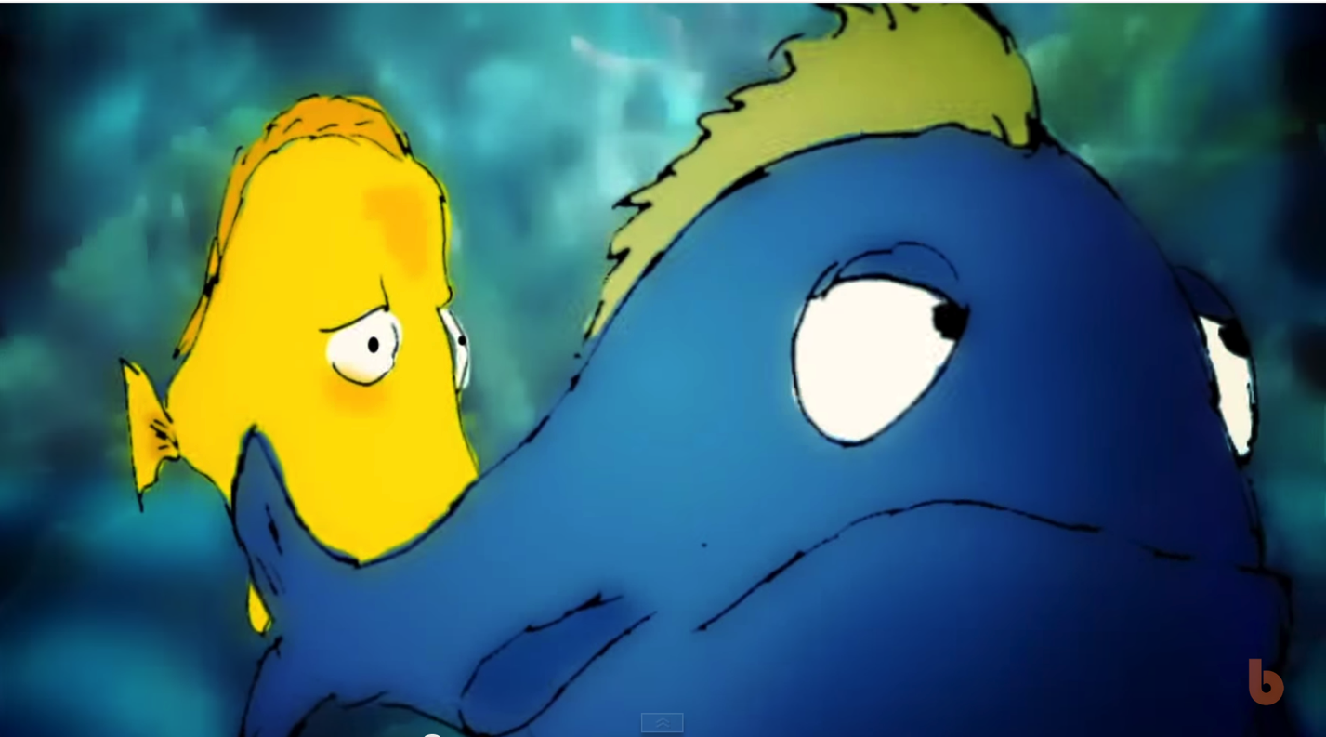
Pre-production: Animatic
So after finishing the model sheets its time to get the animation into an editing program and add initial sound and voice to the scene.

Slide 7
Production
Now that the storyboard has been approved the project enters the production phase. It's here that the actual work can start, based on the guidelines established during preproduction.

Slide 8
Production Components
Modeling
Rigging
Animation

Slide 9
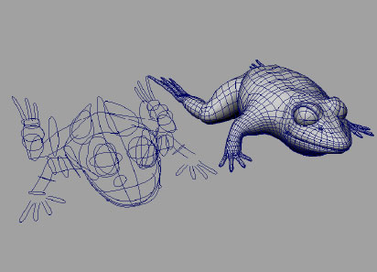
Production: Modeling
In this phase you build your characters from the animatics produced in the previous phase. The model is a 3D object that can move or do any thing.

Slide 10
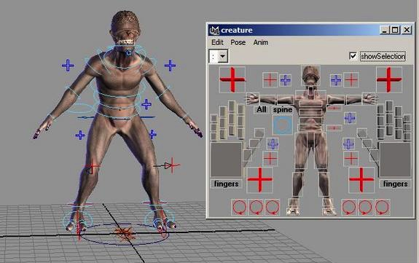
Production: Rigging
Rigging is the process of adding bones to a character or defining the movement of a mechanical object, and it's central to the animation process.

Slide 11
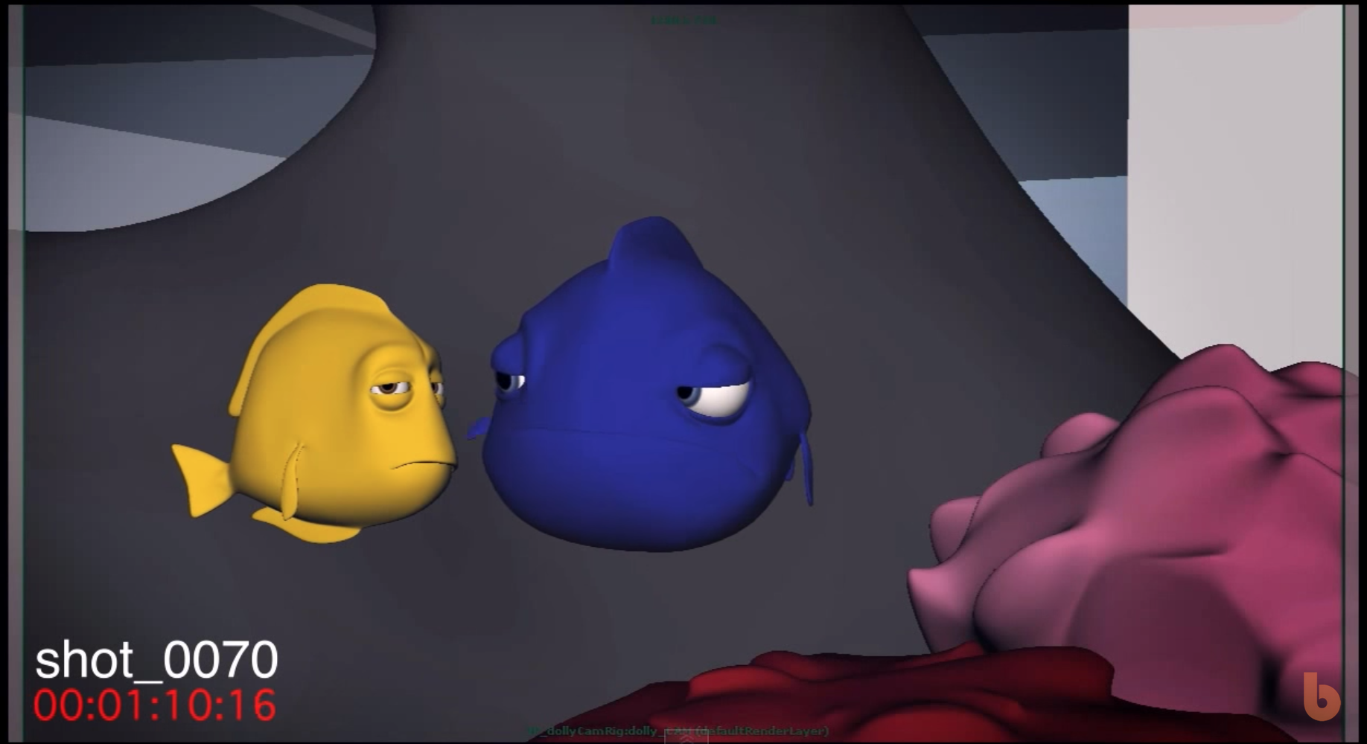
Production: Animation
In this phase you will combine all your models and create the story by moving and make them react and feel like real things.

Slide 12
Post-Production
Post-production is the third and final step in film creation. This includes the editing of raw footage to cut scenes together, inserting transitional effects, working with voice and sound actors and dubbing to name just a few of the many post-production tasks.

Slide 13
Post-Production Components
Lighting and textures.
Rendering
Editing

Slide 14
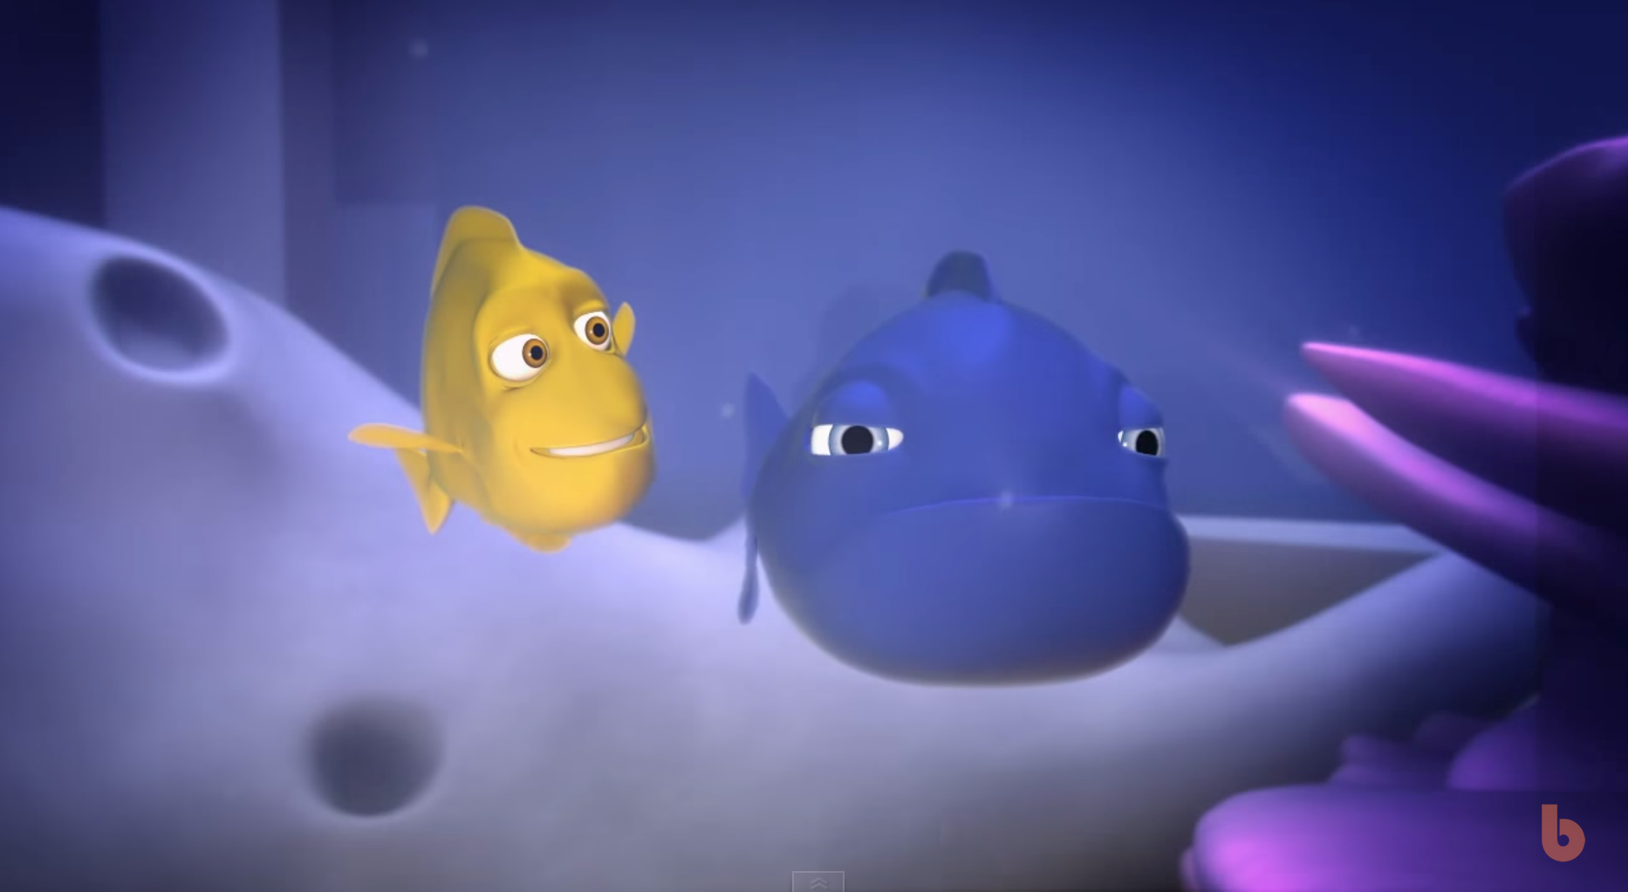
Post-Production: Lighting and textures
After the animation is done, we add the lightings and textures to make the animation looks more like real life.

Slide 15
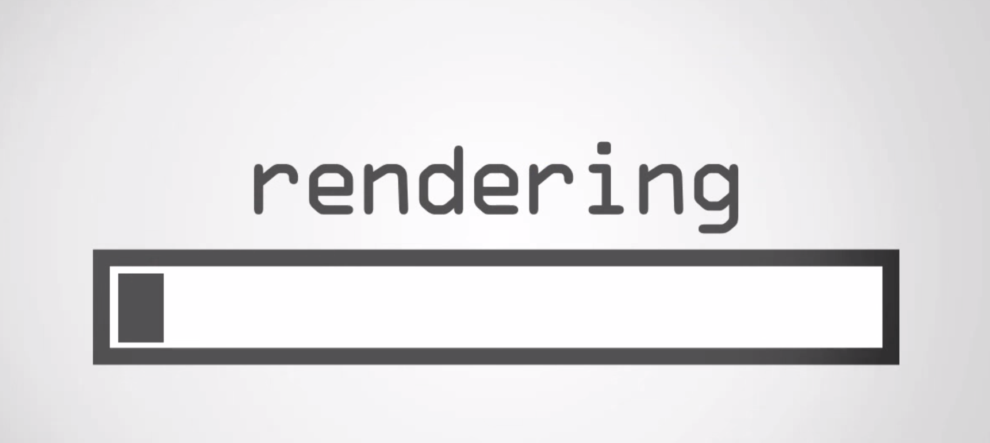
Post-Production: Rendering
In this process we make the animation as a real video that can be edited and add voices to.

Slide 16
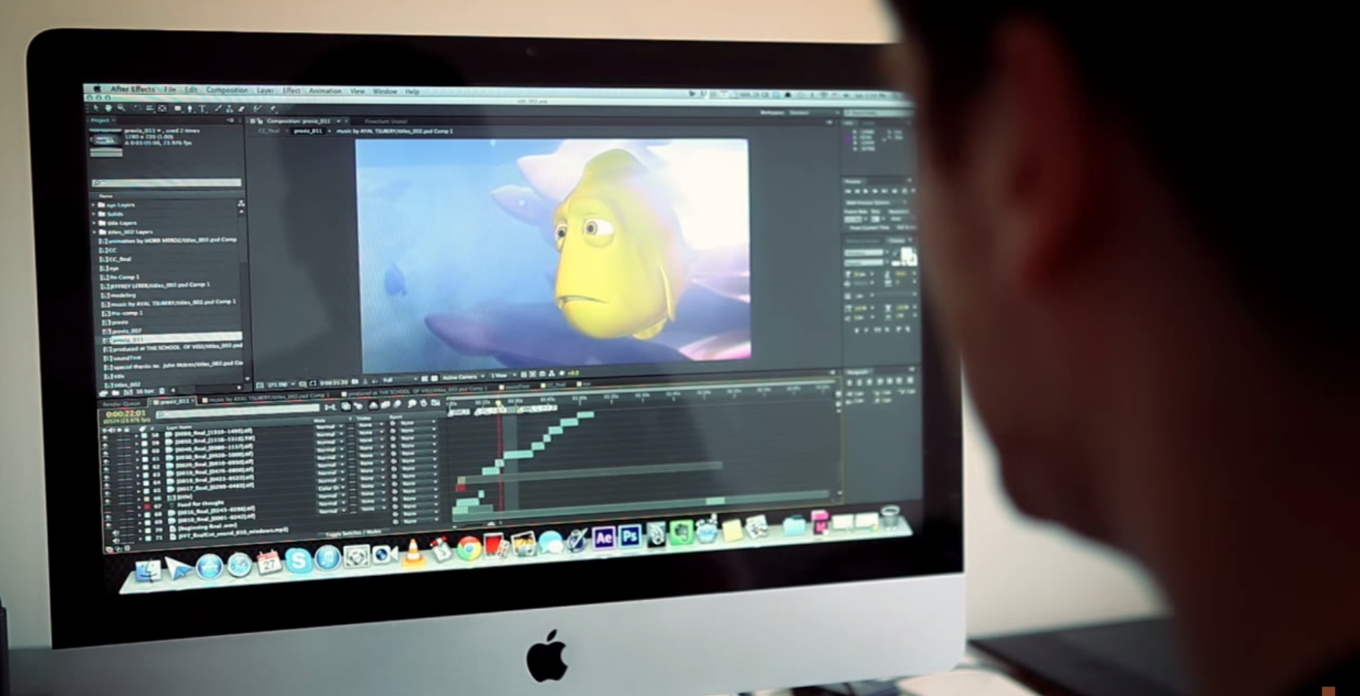
Post-Production: Editing
After the render finishes we will end up with large number of videos without a sound. Here we add them all together and add sounds to them.

